Slide 1

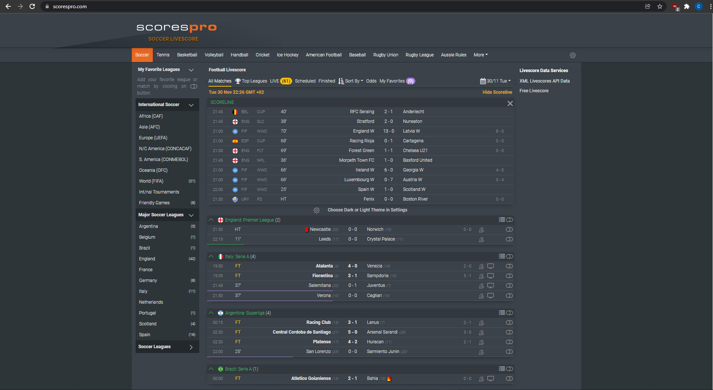
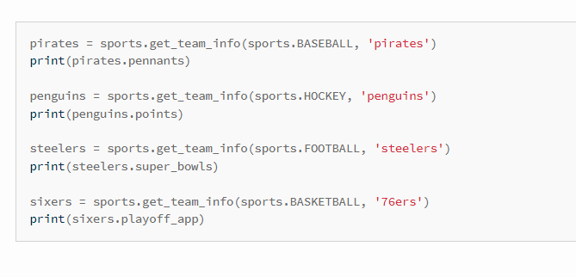
Sports Alert
Coder: Cameron Feldman
GitHub: https://github.com/ksu-is/Sports-Alert
A program that allows a user to retrieve sports information such as scores for their favorite team

